Slide 1
Informer: Beyond Efficient Transformer for Long Sequence Time-Series Forecasting
AAAI 2021
Code: github.com/zhouhaoyi/Informer2020
2021.06.22 • ChongQing
Reported by Chenghong Li

Slide 2
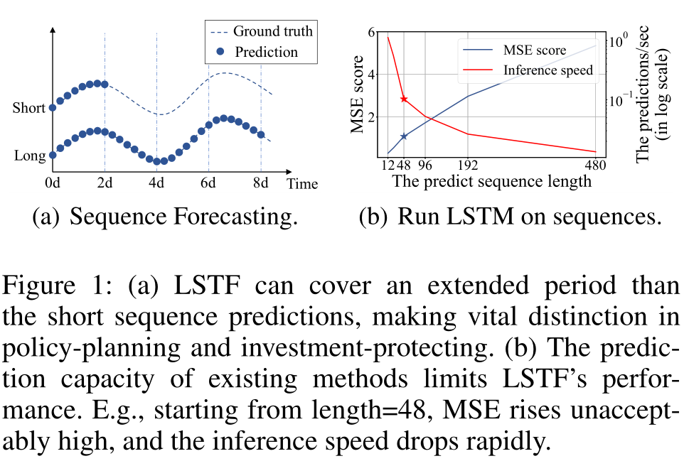
Introduction
Recent studies have shown the potential of Transformer to increase the prediction capacity.
However, there are several severe issues with Transformer that prevent it from being directly applicable to long sequence time-series forecasting (LSTF), including
quadratic time complexity,
high memory usage,
and inherent limitation of the encoder-decoder architecture.

Slide 3
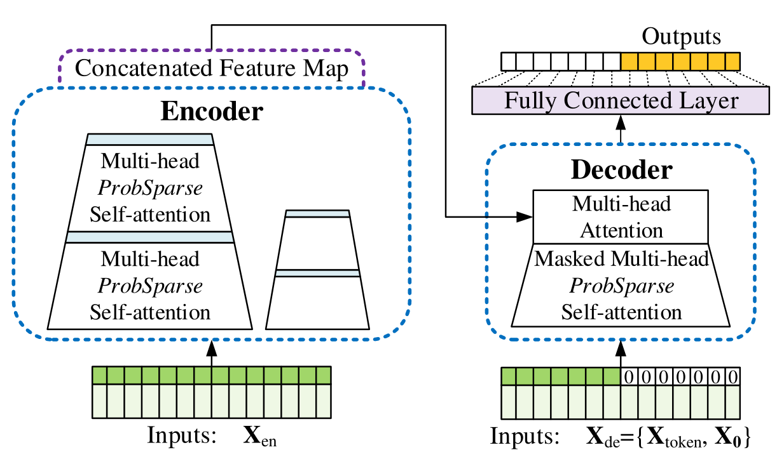
Method

Slide 4
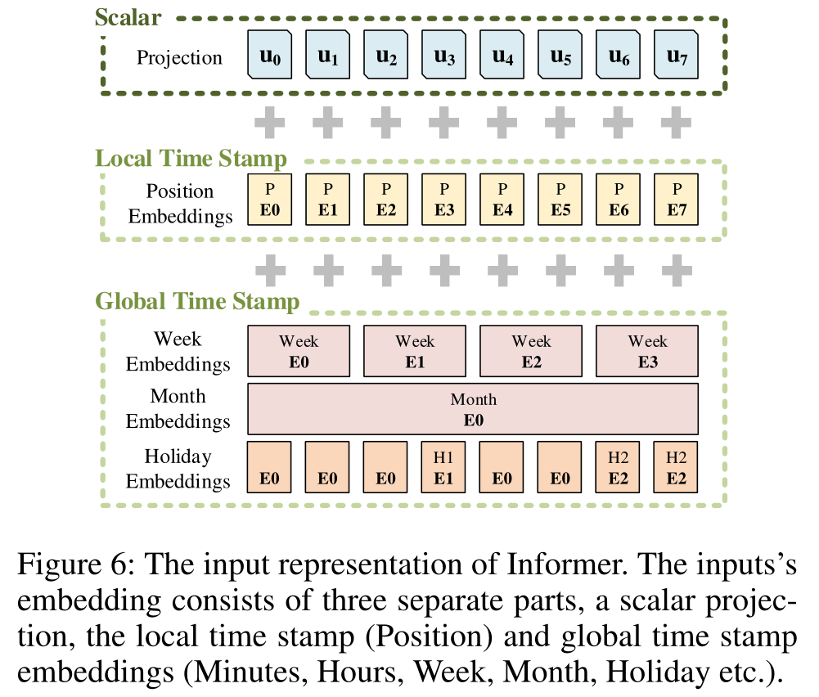
Method
Notes:
使用一维卷积滤波器(kernel width=3, stride=1)将标量上下文xt投射到d-dim向量ut中

Slide 5
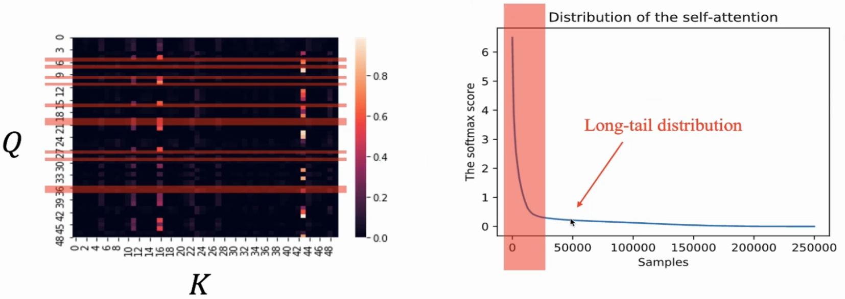
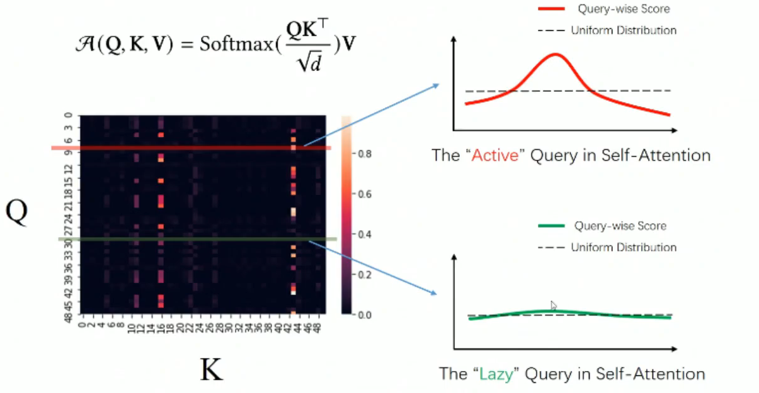
Method
Self-attention
Notes:
(1)概率形式

Slide 6
Method
ProbSparse Self-attention
Attention probability
Uniform probability

Slide 7
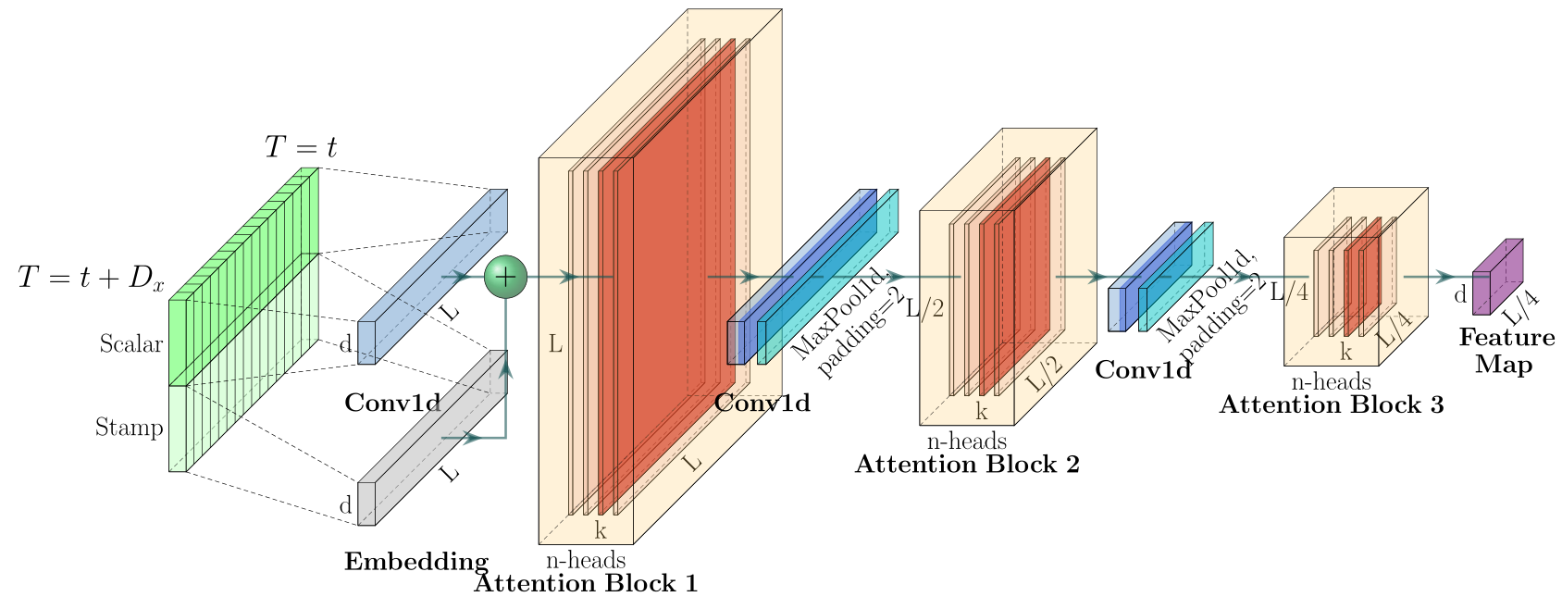
Method
Encoder
Self-attention Distilling:
Decoder

Slide 8
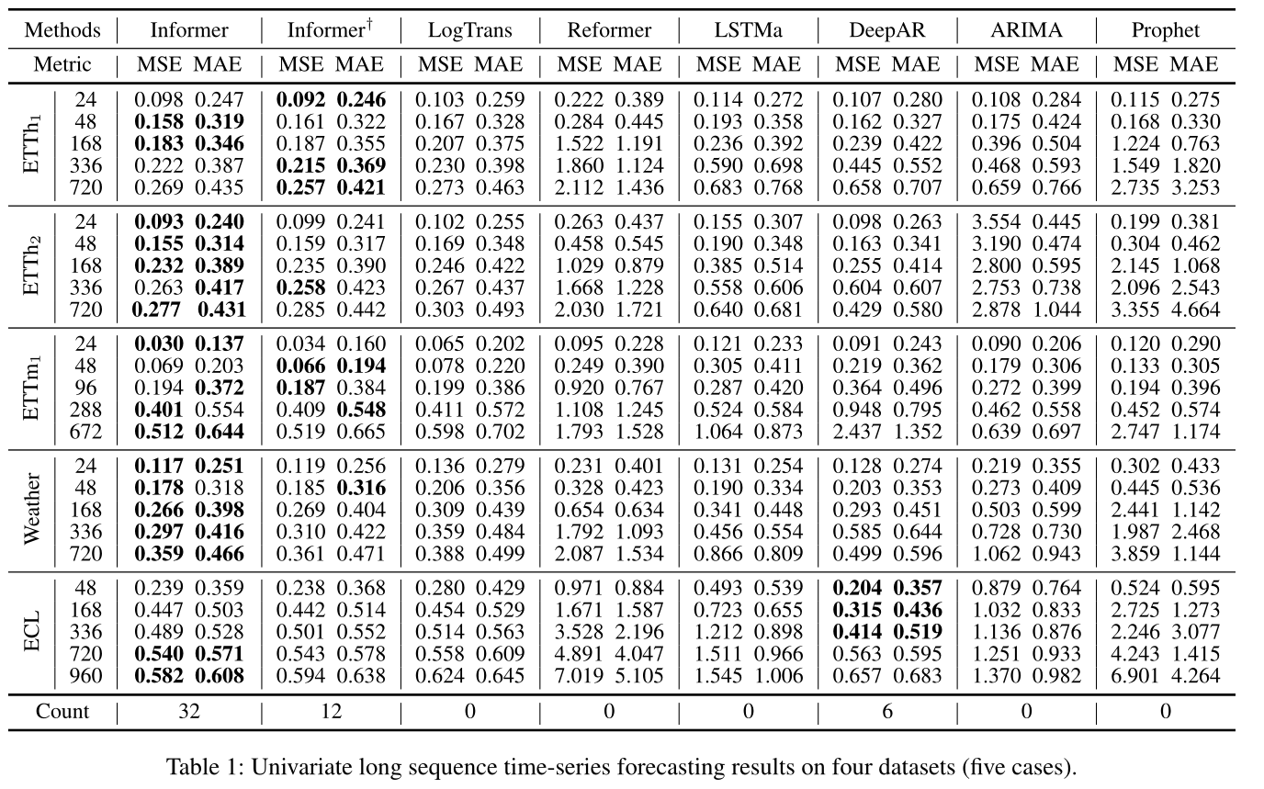
Experiments

Slide 9
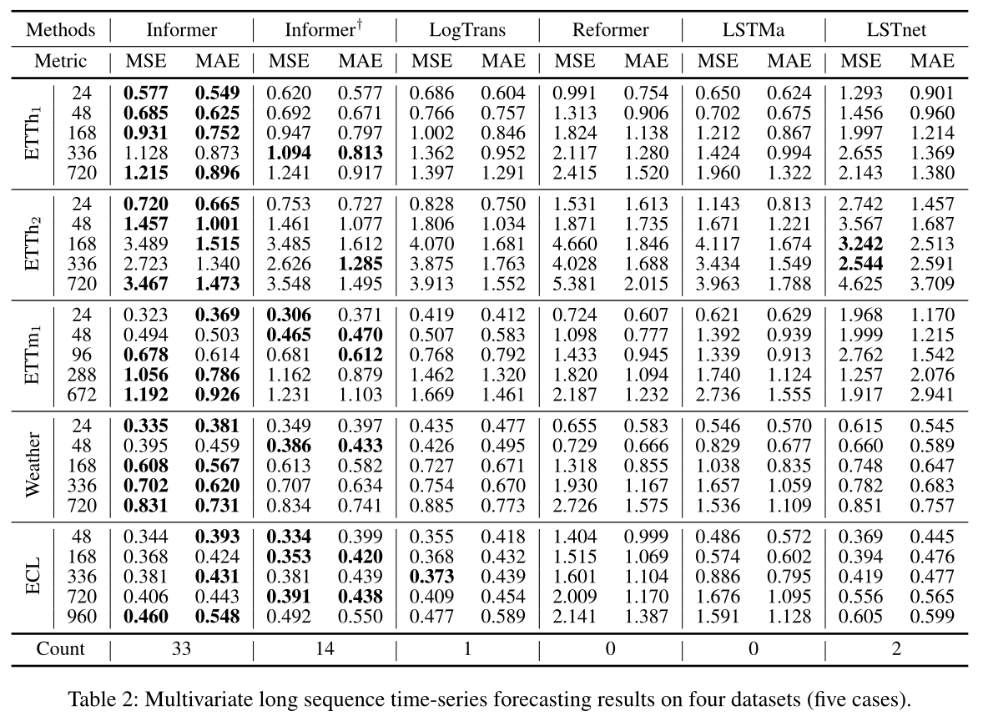
Experiments

Slide 10
Experiments

Slide 11
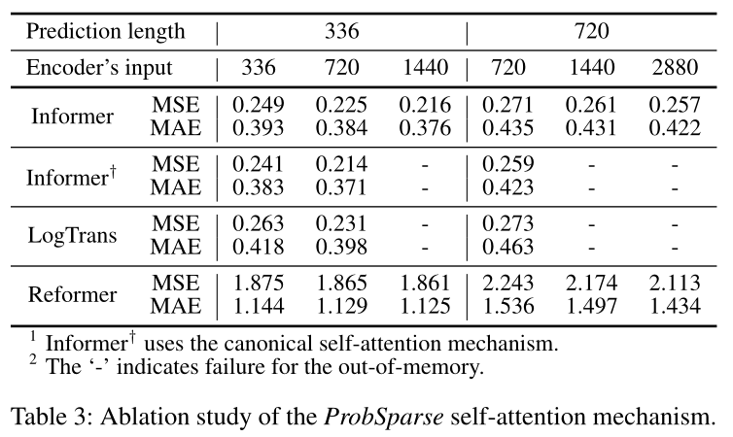
Experiments

Slide 12
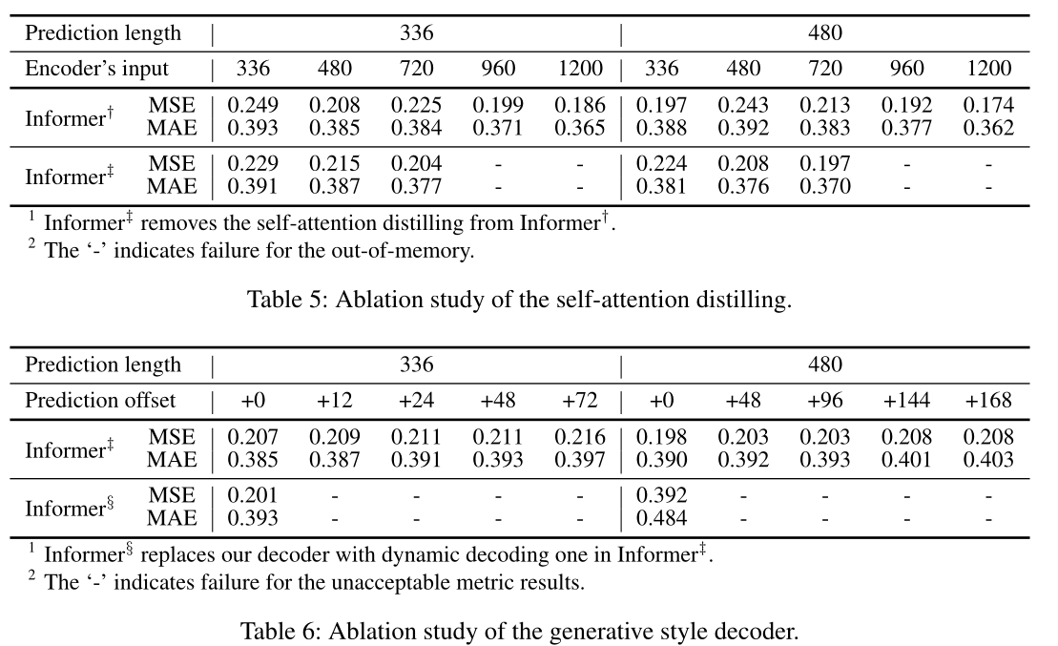
Experiments

Slide 13
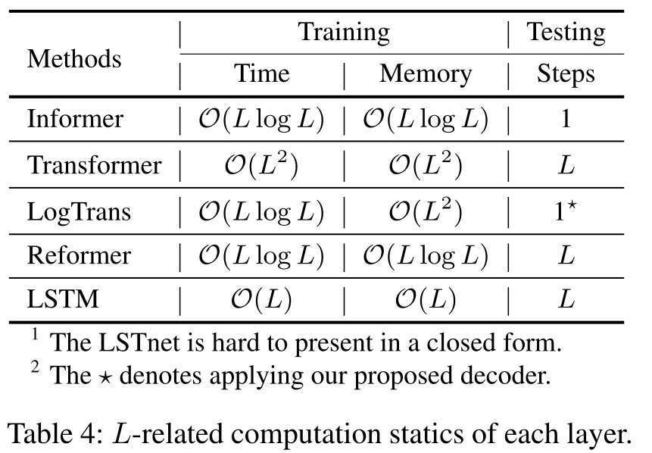
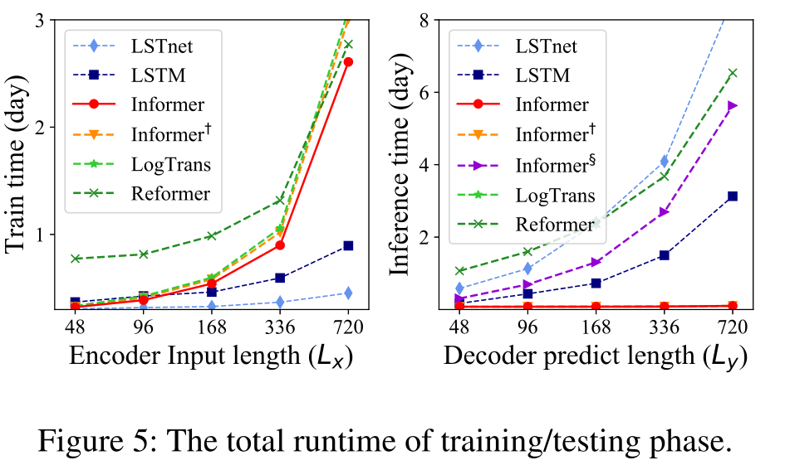
Experiments

